Slide 1
Driver Drowsiness detection using Opencv
Guide: Dr. Dhana Sree Devi V.VISHESH KUMAR(16881A12C0)
K.MANUDEEP(16881A1292)
B.BHUPAL RAJU(16881A1273)

Slide 2
Problem Statement & Outcome
Problem Statement:
Driver fatigue isn’t talked about a lot, but how well we can expect anyone to drive when they are having trouble staying awake. Most of the car accidents caused by drowsy driving occur at night.
As the result, Eyes become "heavy" and blinking time is higher. Driver tends to keep his eyes closed "at least for a few seconds which causes accidents.
Outcome:
If he feels sleep then a” buzz sound” is indicated to alert the driver and also the persons who seated behind can be alerted about the situation. In the event that the driver’s eyes Stay shut for more than a certain duration of time, the driver is said to be languid and an alert is sounded.

Slide 3
Statement about the document
Completed the document and submitted it to the guide.
Waiting for guide’s approval.

Slide 4
Suggestions given in Review 2
To complete the documentation.
Completed the documentation and submitted it to the guide.

Slide 5


Experiments and Results

Slide 6


Experiments and Results

Slide 7
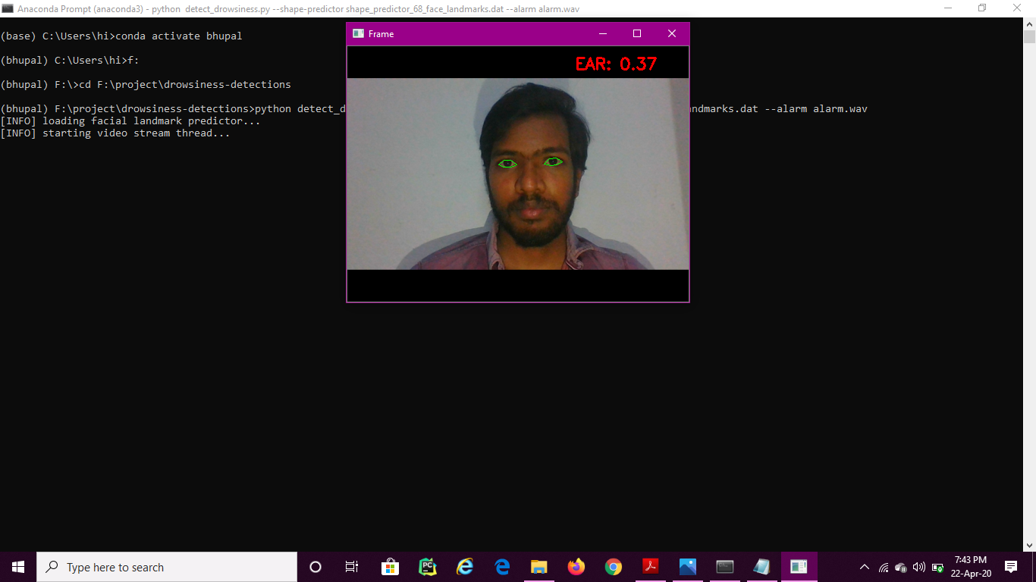

Experiments and Results

Slide 8
Research Paper Outcome
Working on it.

Slide 9


